Slide 1
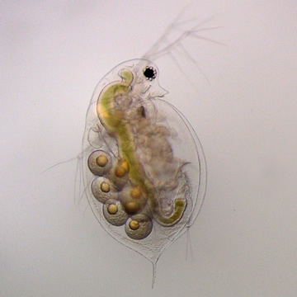
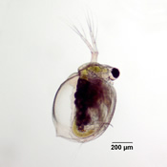
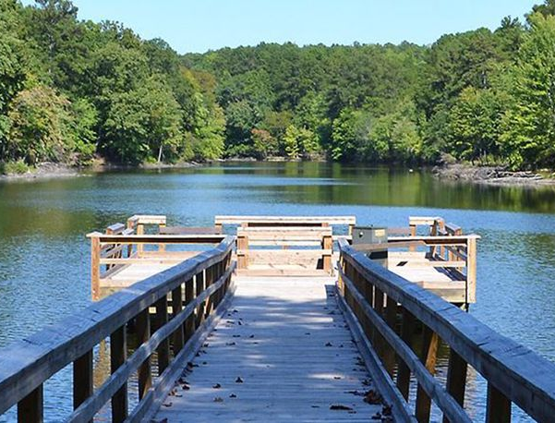
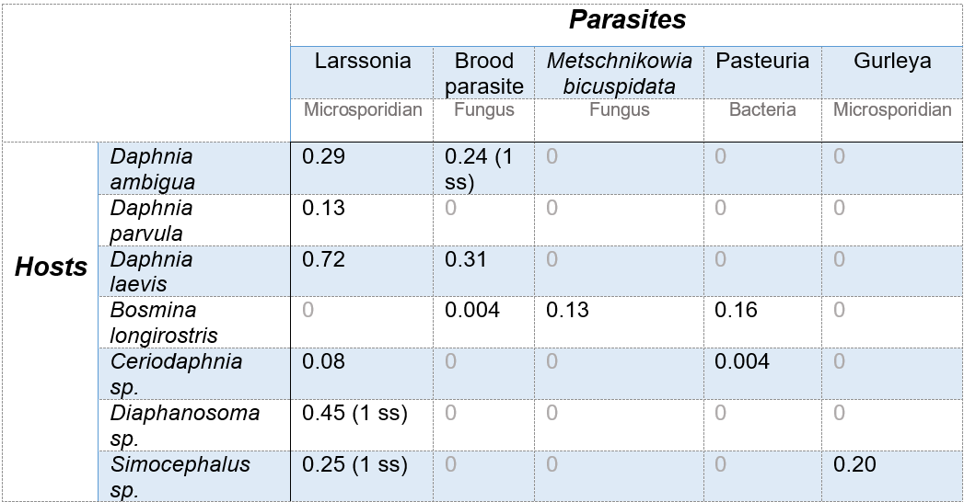
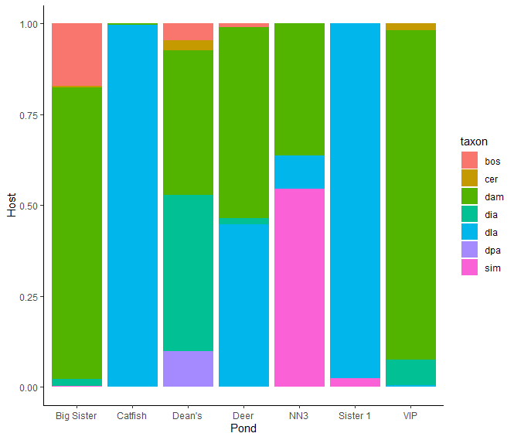
Mysterious microsporidians + friends
Christopher Brandon, Katie Schroeder. Alex Strauss
Odum School of Ecology, University of Georgia, Athens, GA, USA
Background
Days 3, 5, 10, 17, and 24 after Se(VI) addition:
Daphnia ambigua
Ceriodaphnia dubia
Hosts and Parasites
There are ____ ponds in Georgia managed by private owners and local governments
Ponds are commonly habitats for a myriad of zooplankton species
Zooplankton are important grazers in freshwater ecosystems and are commonly infected by a suite of parasites
Parasites can exhibit strong cascading effects on ecosystems
Daphnia parvula
Sampling and Pond Locations
AY
Results
Ponds
Whitehall
Previous work – Microsporidian paper cite
Sampling procedure
Map of Whitehall with pond locations
Motivating Questions
Do other parasites infect zooplankton in these ponds?
Do they overlap with microsporidian infections?
Are there physical and chemical pond features correlated with infection?
Conclusions

Slide 2
Daphnia parvula
Daphnia ambigua
Daphnia ambigua
Daphnia ambigua
Daphnia ambigua
Ceriodaphnia dubia

